Slide 1

Web Development 1
© Hugh McCabe & Matt Smith 2008-2014
HTML IDs

Slide 2
Class vs. ID
ID attribute similar to class attribute
Key difference between ID and CLASS
can be MULTIPLE elements in a page of the same class
Can only be ONE element with a given ID
<img src=“mypic.gif” class=“hughimages” />

Slide 3
ID
Can use id attribute to define unique ID for an element
Value of id must be used only once in a page,
Any element may have an ID
For example:
<li id = “isbn200453”>The Gathering</li>
Uniquely identifies that list item
We can use more or less anything we want as values of the id attribute
Start with LETTERS
Case sensitive – so always use lower case unless

Slide 4
ID
Can construct CSS style rule to target that element
Use hash (#) symbol as follows:
li#isbn200453 { color: red; }
This will make any list items with the id value of ISBN200453 (there should be only one), turn red.
Because these id value are unique we can omit the element name e.g.
#isbn200453 { color: red; }
Hash (#) symbol used to indicate ID value in CSS rule selector

Slide 5
ID Selectors - Example
<body>
<ul>
<li id=“isbn200452">No Country For Old Men</li>
<li id=“isbn200453">The Gathering</li>
<li id=“isbn200454">The Mission Song</li>
</ul>
</body>
</html>
HTML
#isbn200453 {
color: olive;
}
CSS

Slide 6
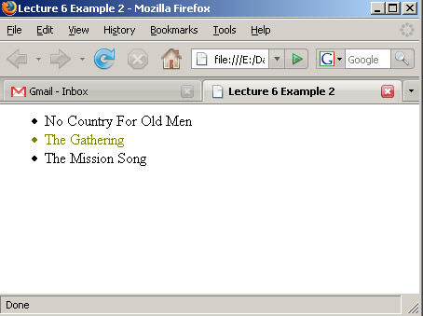
ID - Example

Slide 7
Generally CLASSes are fine
Even if there is only one in a page
But you may meet IDs in other peoples CSS code
And as long as it meets the criterion that THERE CAN BE ONLY ONE element with a given ID in a page
Then IDs are fine

